Slide 1
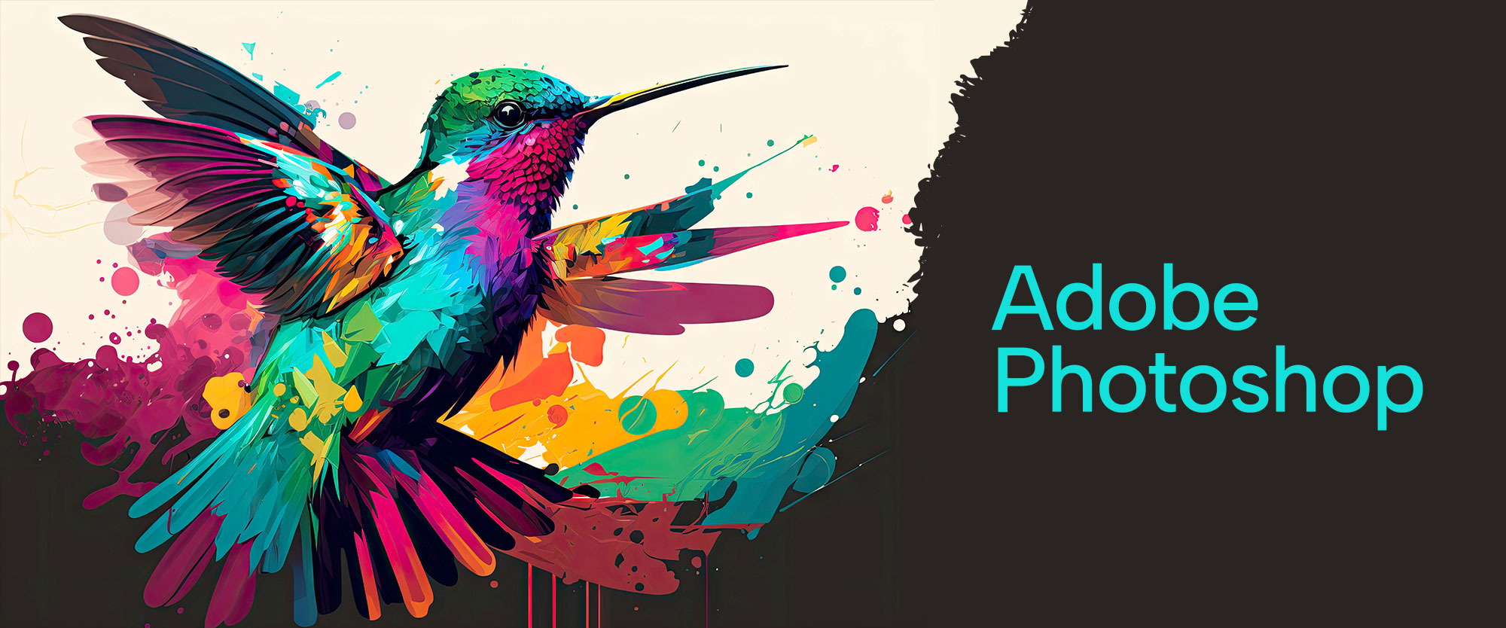

Slide 2
About today…
3D Tools and Features

Slide 3
What Are 3D Tools in Photoshop?
Definition
3D tools in Photoshop allow you to create and manipulate three-dimensional objects and scenes directly within the application
Key Features
3D Workspace
A dedicated workspace for 3D editing
3D Layers
Layers that include 3D content such as text, shapes, and models
3D Panel
Access to 3D settings, including lighting, materials, and textures

Slide 4
Creating 3D Objects
Types of 3D Objects
3D Workspace
Convert text layers into 3D objects
3D Layers
Create 3D geometric shapes like cubes, spheres, and cones
3D Panel
Import and manipulate 3D models from external sources
How to Create
Text to 3D
Select text layer, go to 3D > New 3D Extrusion from Selected Layer
Basic Shapes
Go to 3D > New 3D Postcard from Layer and choose shape
Import Models
Use 3D > New 3D Layer from File to bring in external 3D models

Slide 5
Manipulating 3D Objects
Transform Tools
Rotate
Adjust the rotation along X, Y, and Z axes
Scale
Change the size of the 3D object
Move
Reposition the 3D object within the scene
Editing Tools
3D Camera Tool
Adjust the camera angle and perspective
3D Object Tool
Modify the properties and texture of 3D objects

Slide 6
Adding and Adjusting Lighting
Types of Lights
Spotlight
Focused light source with adjustable direction
Point Light
Light that emits in all directions from a single point
Infinite Light
Light source that simulates sunlight
Adjusting Light
Position and Intensity
Control the location and strength of the light source
Shadows
Modify shadow softness and opacity

Slide 7
Applying Textures and Materials
Textures
Import Textures
Add textures to surfaces to give them a realistic appearance
Adjust UV Mapping
Modify how textures wrap around 3D objects
Materials
Material Editor
Change properties like color, shininess, and reflectivity
Apply Materials
Assign different materials to different parts of the 3D object

Slide 8
Rendering 3D Scenes
Render Settings
Quality
Choose between Draft, Standard, and Best quality for rendering
Output
Set resolution and file format for the final render
Process
Render View
Preview the scene before final rendering
Final Render
Generate the high-quality image or animation of the 3D scene

Slide 9
Practical Tips and Best Practices
Optimize Performance
Work with lower resolution models for faster editing and high-resolution textures for final rendering
Use Guides and Grids
Utilize guides and grids to align and position objects accurately
Regularly Save
Save different versions of your project to avoid losing progress
Experiment with Lighting
Test various lighting setups to achieve the desired effect

